Slide 1
Bay Hacks:
Password Manager
September 7, 2024
Yunhan Luo and Brandon Zhang

Slide 2
Introduction
Our Team: Yunhan Luo and Brandon Zhang
Our Track: Cybersecurity
Our App: Password Manager

Slide 3
Features
Password Manager in the Cloud
Password Generator
Password Export Tool

Slide 4
How We Built the App
We used Python for the backend
Streamlit
We used Streamlit for UI
OpenAI
We used OpenAI to create helpful mnemonics

Slide 5
Dependencies
Streamlit
OpenAI Python Module
IO Module
Random
Pandas

Slide 6
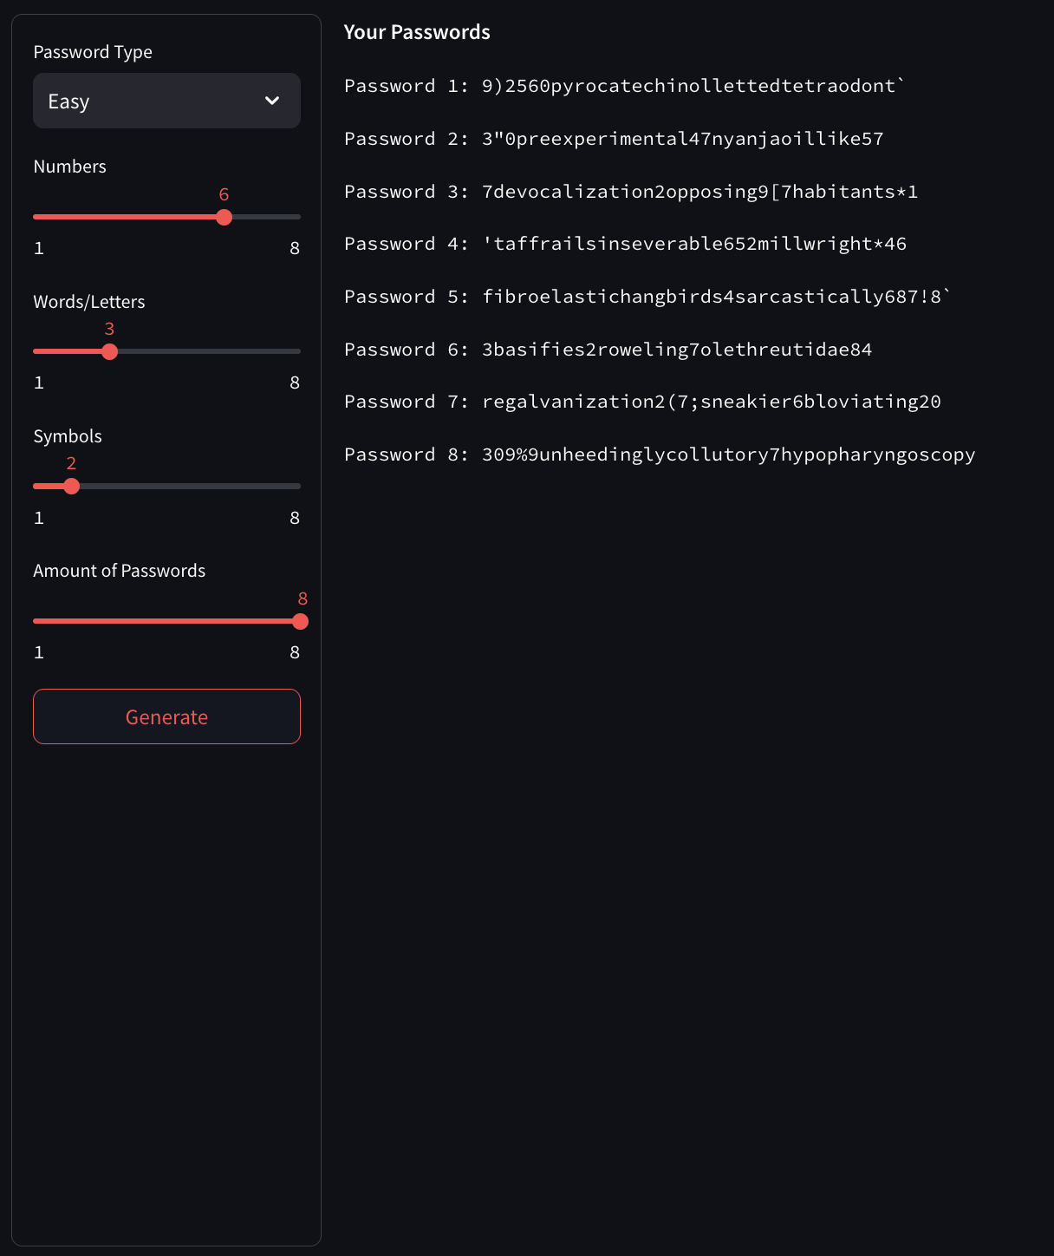
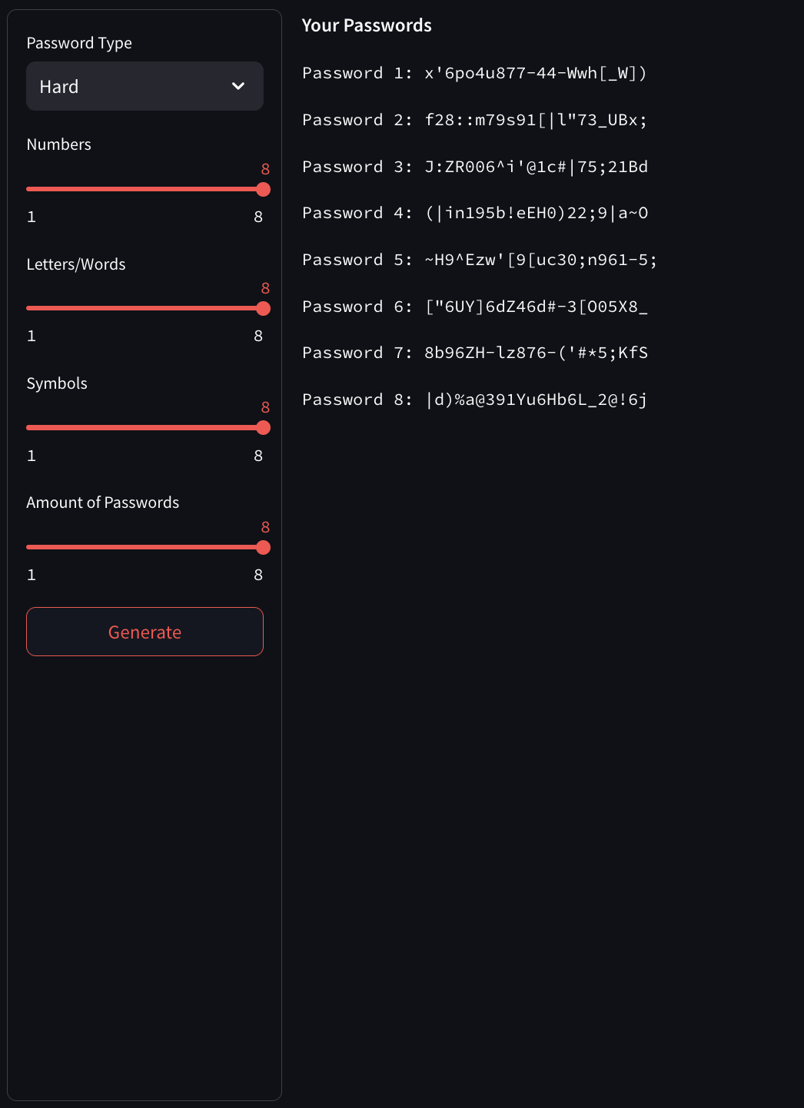
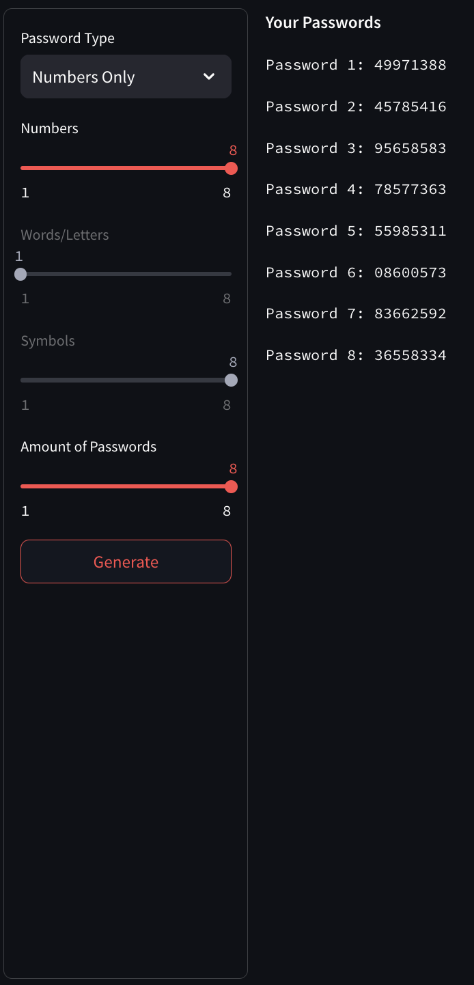
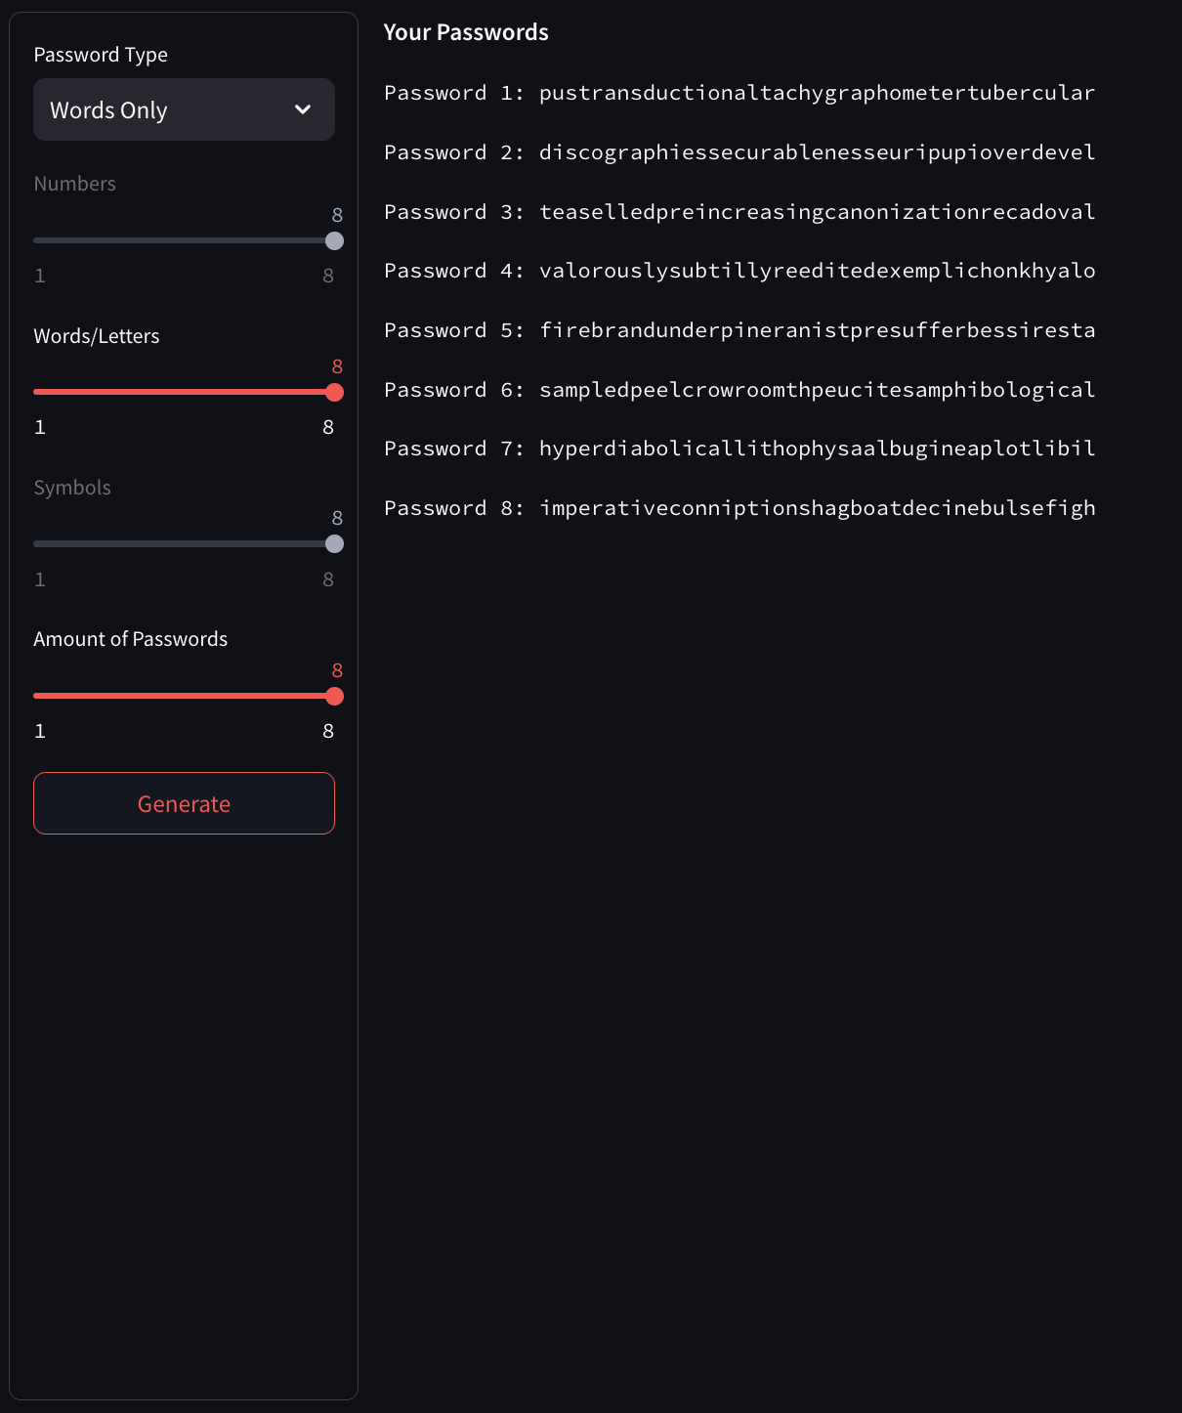
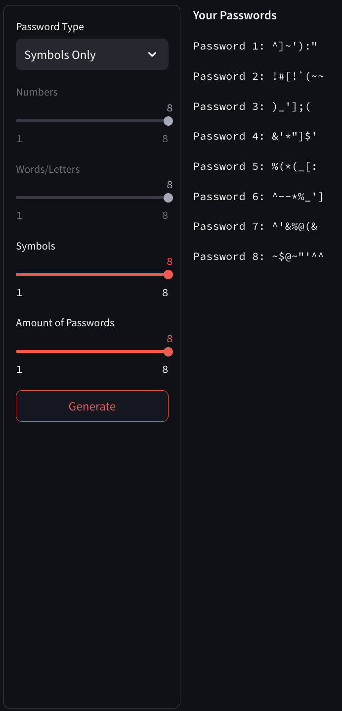
Password Generator
We used a list of random words, letters, numbers, and symbols to create memorable and secure passcodes for the user.
There are scroll bars for every password that appears shorter than they should be considering the settings

Slide 7
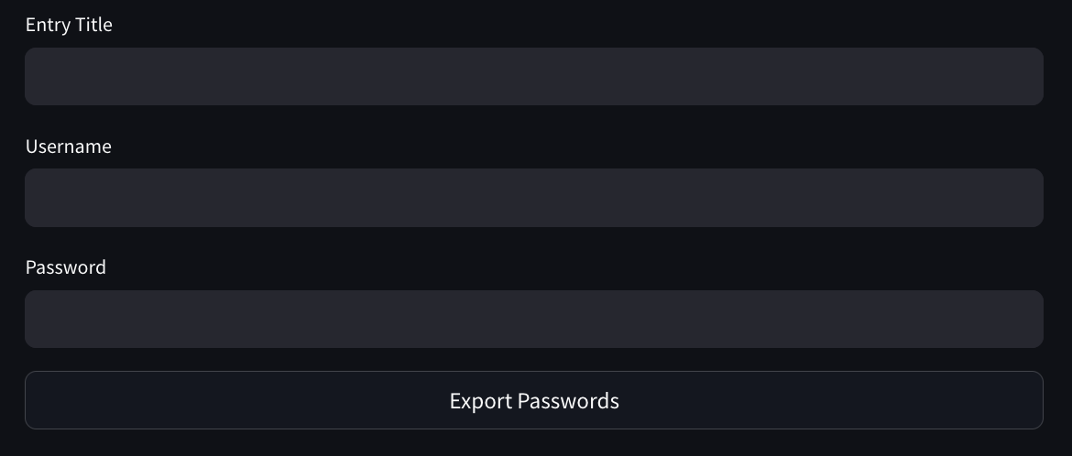
Password Exporter -> CSV
If you provide all inputs
in the export page,
You can download a CSV file
that you can import to
any other program of your choice.

Slide 8
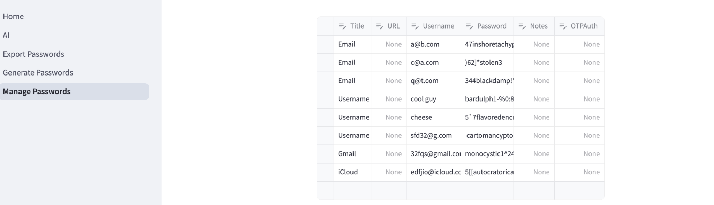
Password Manager
The Password Manager is a simple graph that stores all of your passwords in one place.

